Slide 1
MINI PROJECT Clustering – Mall Customers Segmentation
By,
B.Jagadhesh,
DSFT8

Slide 2
Mall Customers Segmentation :
Customers who come for shopping in a mall can be grouped in a number of ways. Shopping pattern,spending pattern, shopping score, salary etc. are some of the factors that can be used to divide the customers into different categories.
The reason for these clusters is to help identify those customers who would be interested in certain products, offers and services. The store may strategize its offerings in such a way that it targets only right customers for specific products. This helps in creating a win-win situation for both the store (in terms of revenue and more customers through customer recommendation) and the customer (discounts, offers, reward points, gifts, etc).
Business Objective :
To create Customer cluster to identify the different types of customers

Slide 3
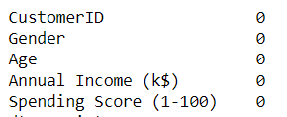
Data Set :
The given data has 200 Rows and 5 Columns.
This data contains no null values so we can proceed with the model building.
This given data set is very small.
Gender is the only object column in the data.

Slide 4
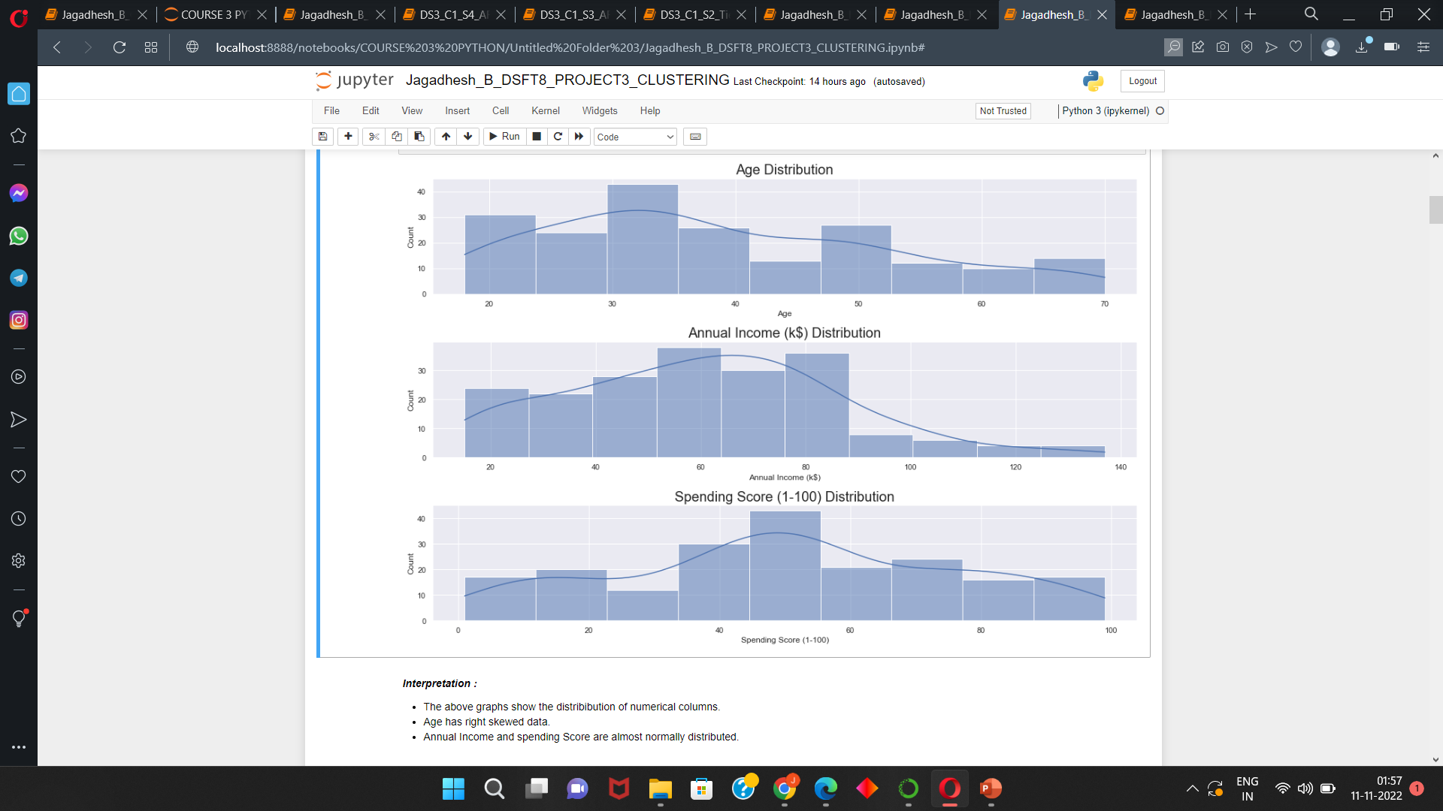
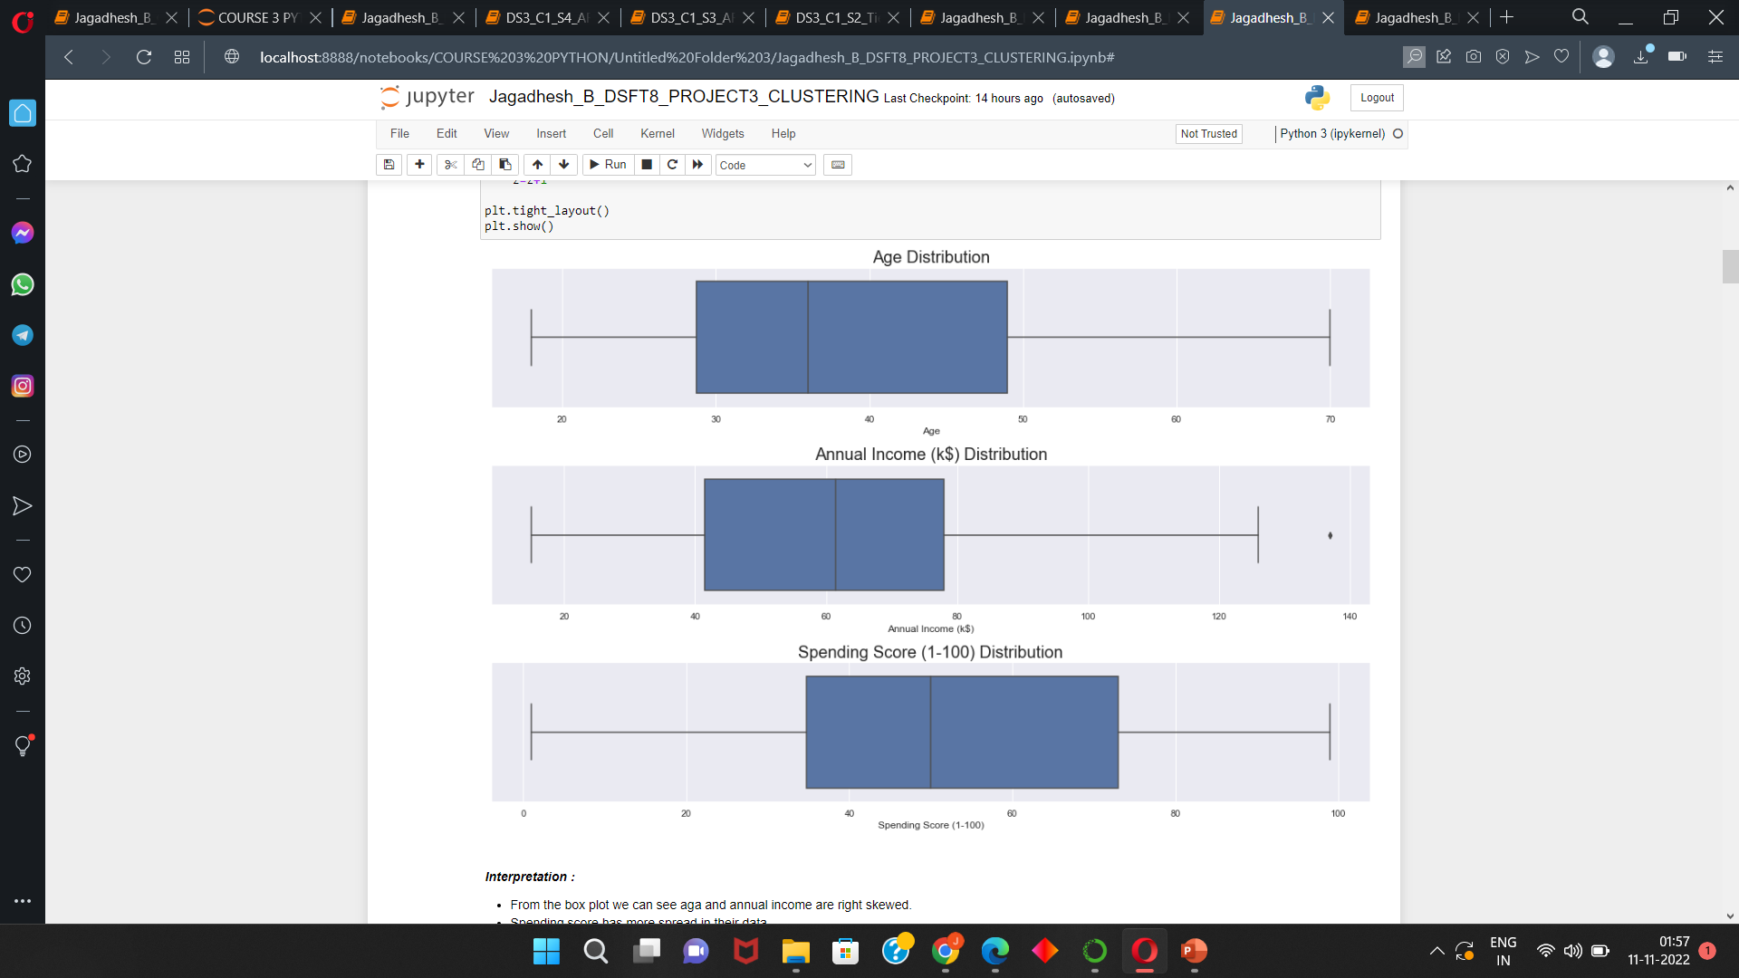
EDA : Univariate, Bivariate and Multivariate Analysis
The above graphs show the distribution of numerical columns.
Age has right skewed data.
Annual Income and spending Score are almost normally distributed.
From the box plot we can see aga and annual income are right skewed.
Spending score has more spread in their data.
We cant find any outliers in the data.

Slide 5
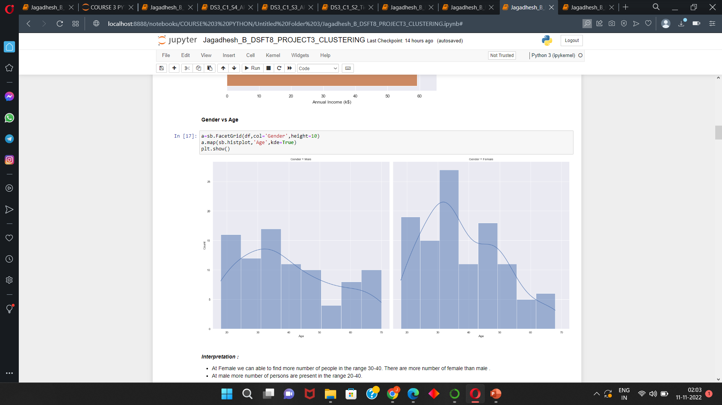
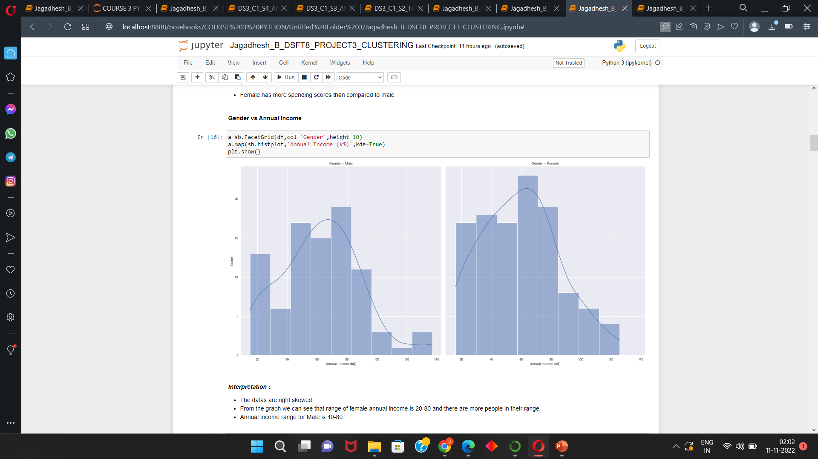
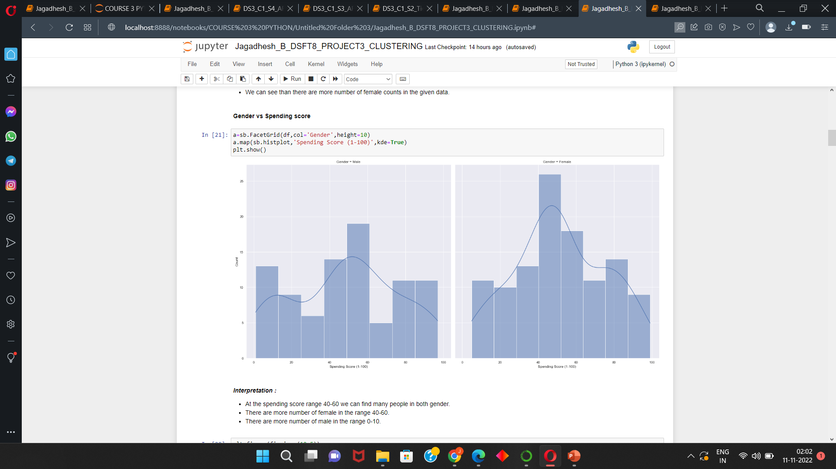
EDA : Univariate, Bivariate and Multivariate Analysis
At Female we can able to find more number of Gender vs Age :
people in the range 30-40. There are more number of
female than male .
At male more number of persons are present in the
range 20-40.
The datas are right skewed. Gender vs Annual income :
From the graph we can see that range of female
annual income is 20-80 and there are more people
in their range.
Annual income range for Male is 40-80.
At the spending score range 40-60 we can find Gender vs Spending score :
many people in both gender.
There are more number of female in the range
40-60.
There are more number of male in the range 0-10

Slide 6
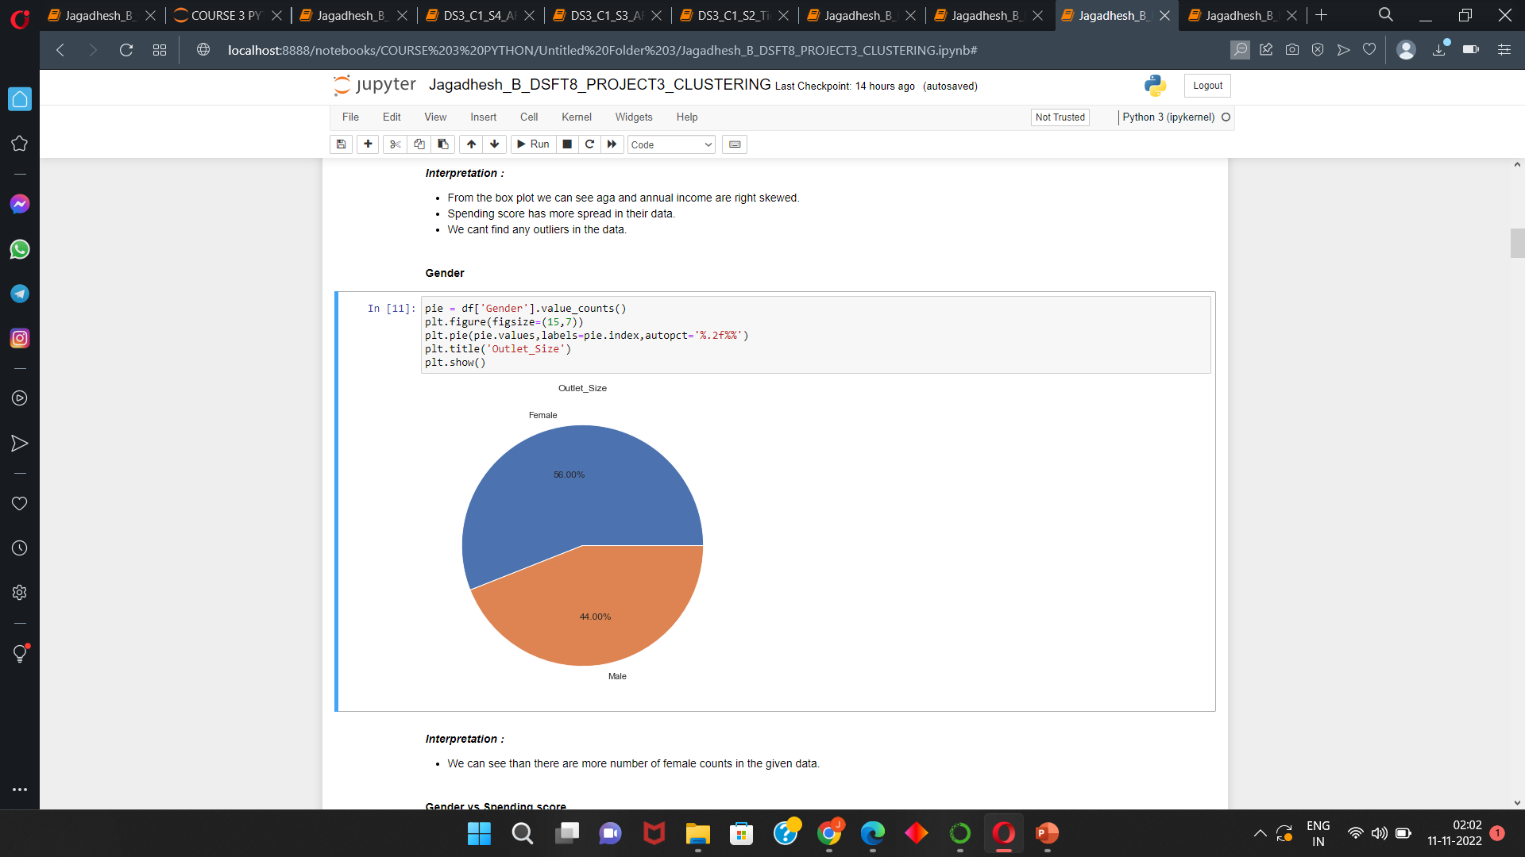
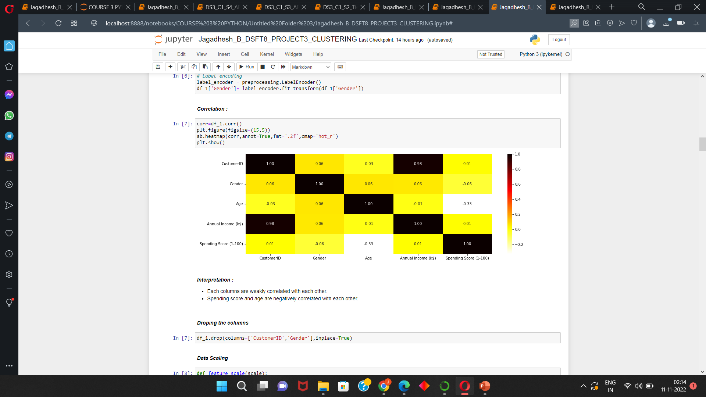
EDA : Univariate, Bivariate and Multivariate Analysis
More number of female counts in the given data.
Each columns are weakly correlated or not having correlation with each other.
Spending score and age are negatively correlated with each other.

Slide 7
Preparing the Data set :
Machine Learning models works well with numeric data.
DATA PREPROCESSING :
Models performs well with numeric data .So we are converting all the columns which are in object and category we are converting them to numeric by using label encoder.
DATA SCALING :
In the given data set the value ranges can be different so we need to convert the data to some range for the good performance. The data are Normalized(0 to +1) using MimmaxScalar().
FEATURE SELECTION :
Features are checked for correlation with the dependent column and the most correlated columns are chosen for the models for the best performance.
DATA SPLITTING :
This is unsupervised model so we need to take whole data.

Slide 8
Clustering Machine learning model :
Types of clustering models ,
1) Kmeans
2) Heirarchichal Clustering,
a) Single
b) Average
c) Complete
d) Ward
3) Density based clustering i.e) DBSCAN
Here we are using actual data and pca data i.e) Feature reduction method and comparing them by Silhouette score and visualization .

Slide 9
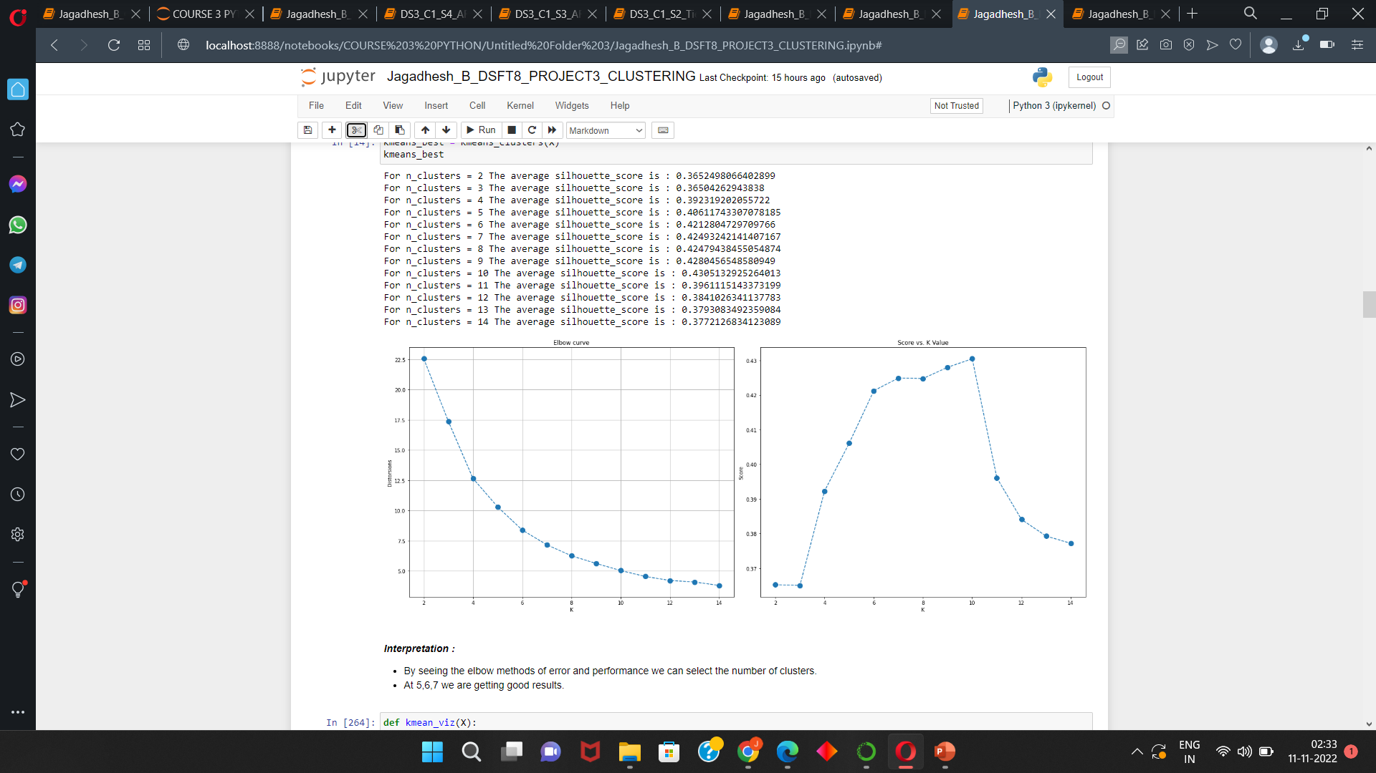
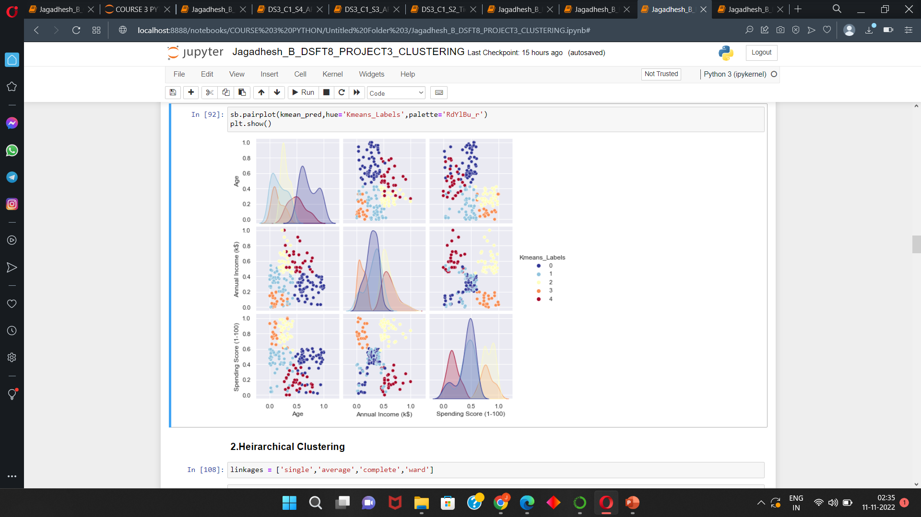
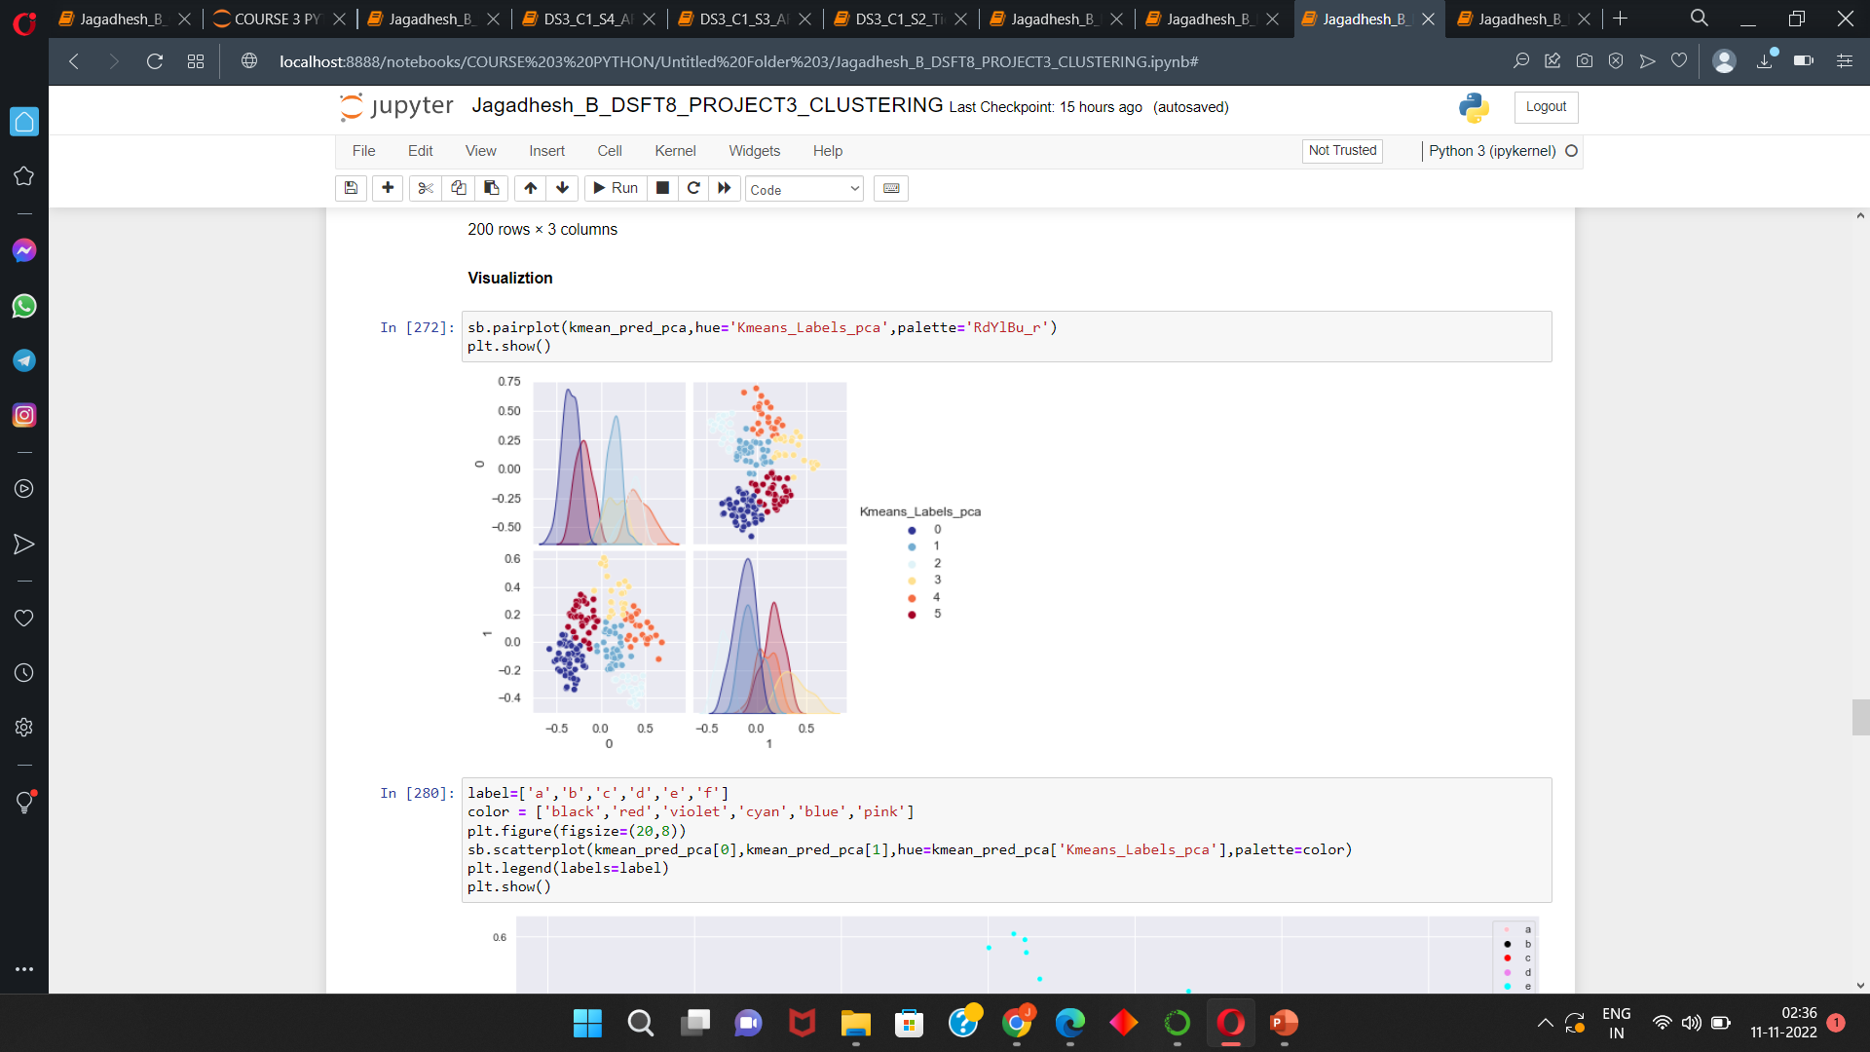
KMeans visual for actual and pca data :
For kMean we need to set number of clusters required , for selecting that we are using Elbow method and
checking for the Silhouette Score for different clusters.
The Silhoutte score for Kmeans in actual and pca data are 0.4061 and 0.4504 respectively.
From the below plots we can see that the clusters are formed well .we can able to see clear cluster seperation
For both actual and pca data.

Slide 10
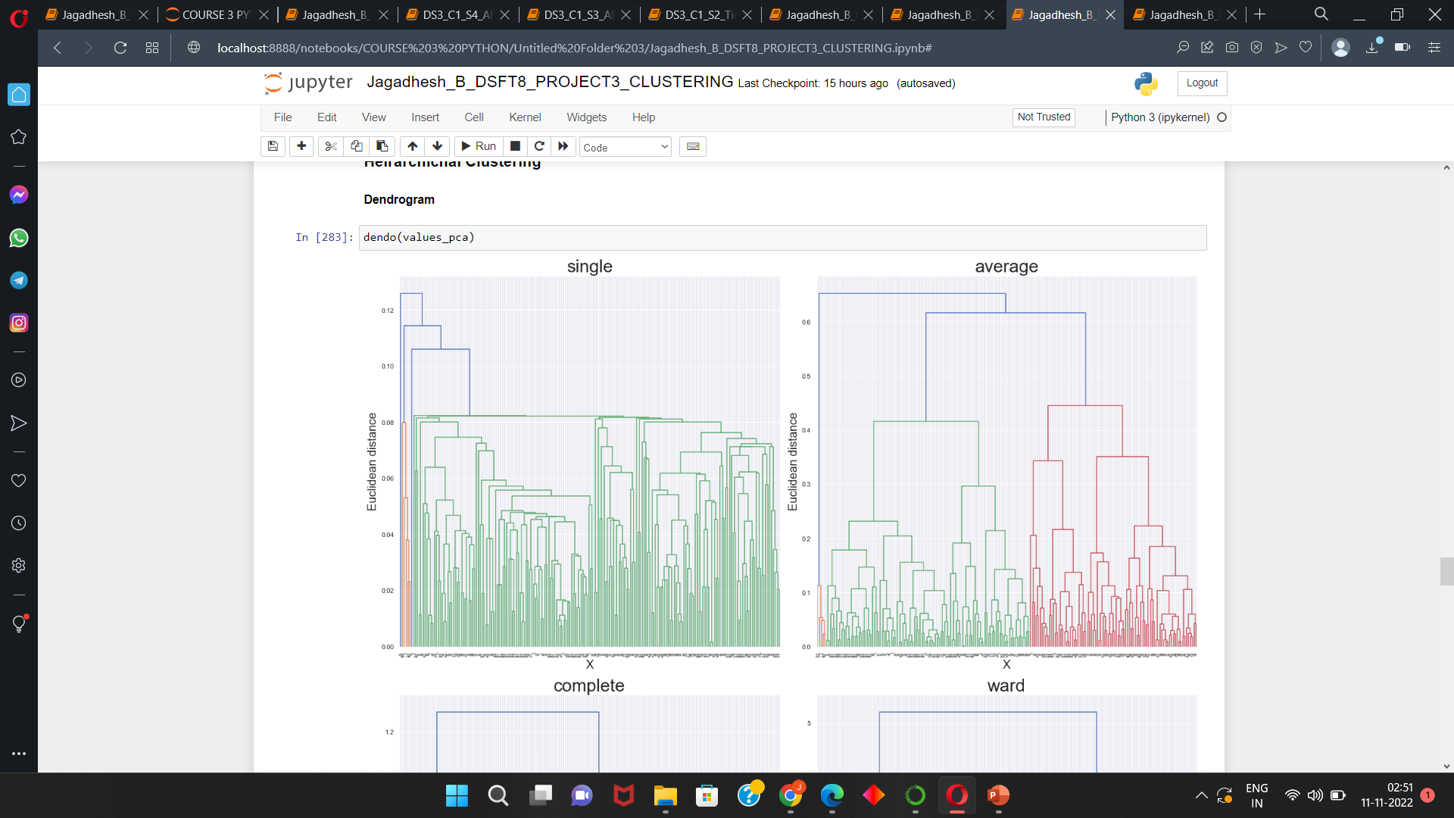
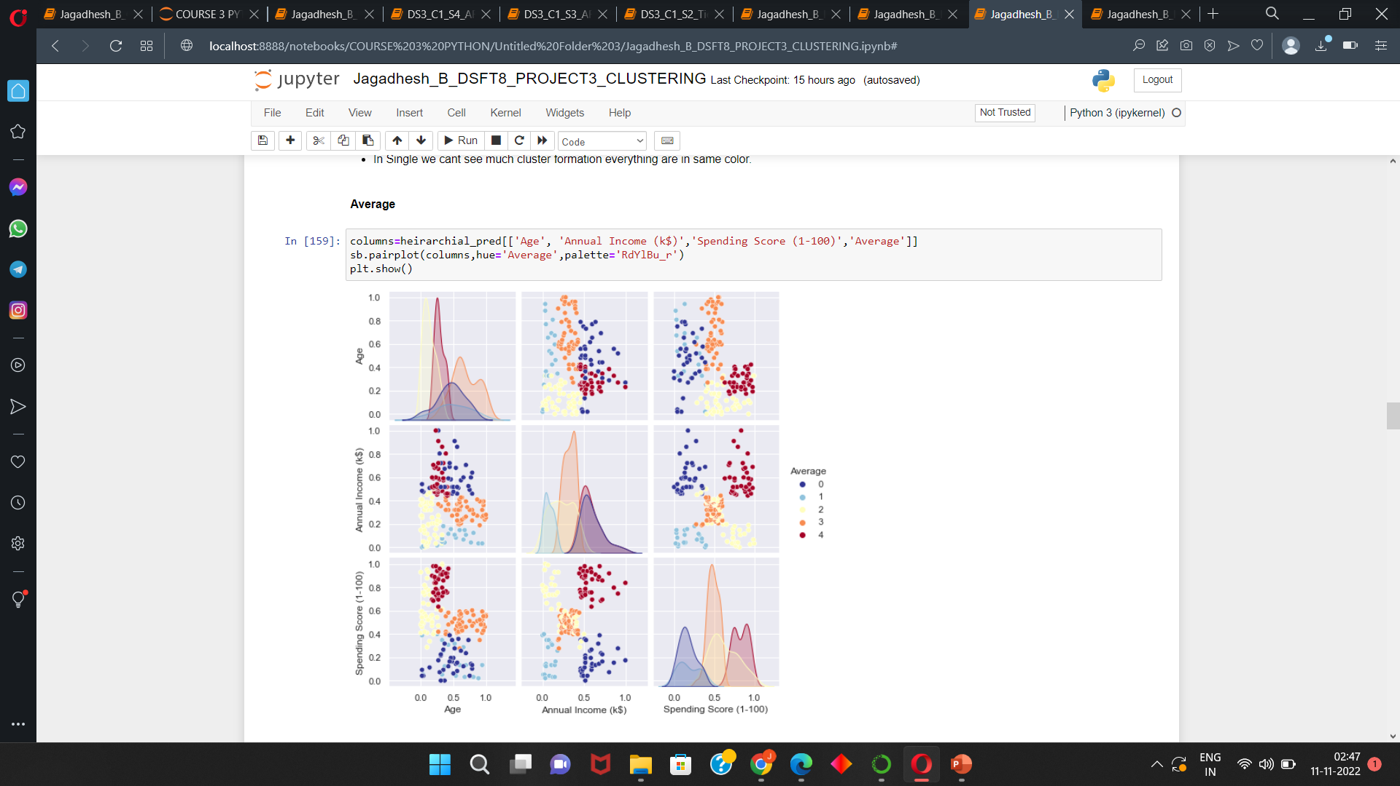
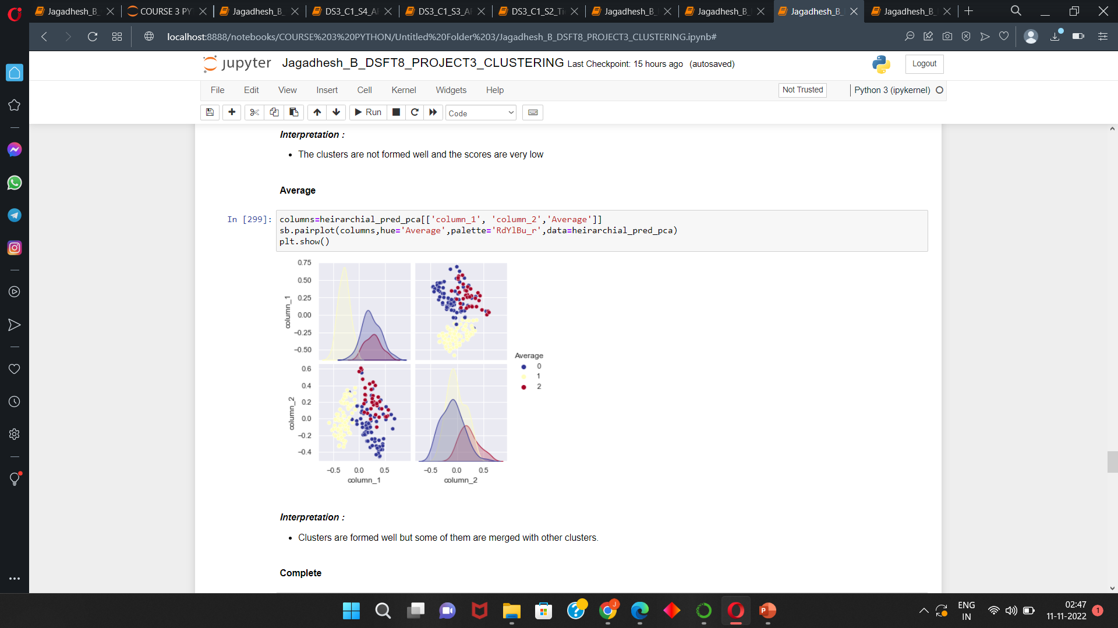
Hierarchical visual for actual and pca data :
For Hierarchical we need to set number of clusters required , for selecting that we are using Dendrograms
for different linkage methods.
We are getting good clusters in average linkage for both actual and pca data.
The Silhoutte score for Agglomerative using average linkage method in actual and pca data are 0.3982 and 0.39285
respectively.
From the below plots we can see that the clusters are formed well .we can able to see clear cluster seperation
For both actual and pca data. But not that much good as the kMeans

Slide 11
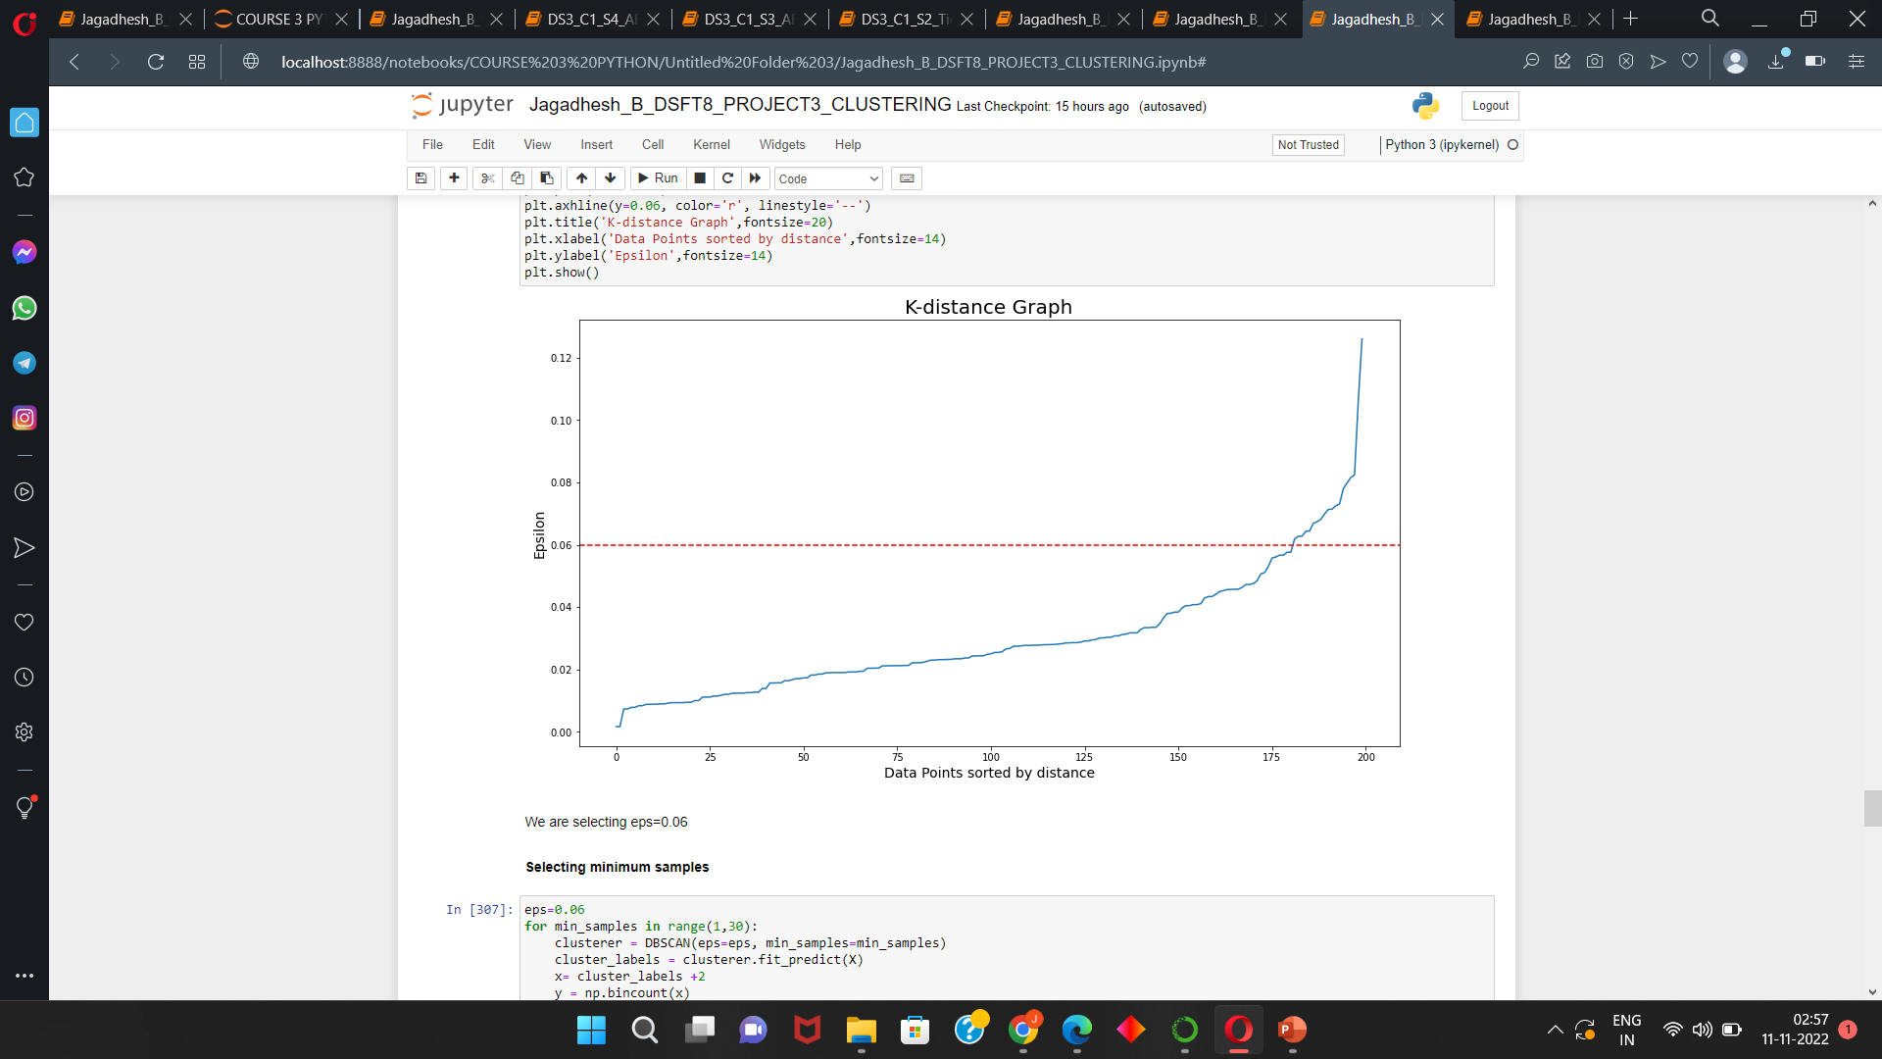
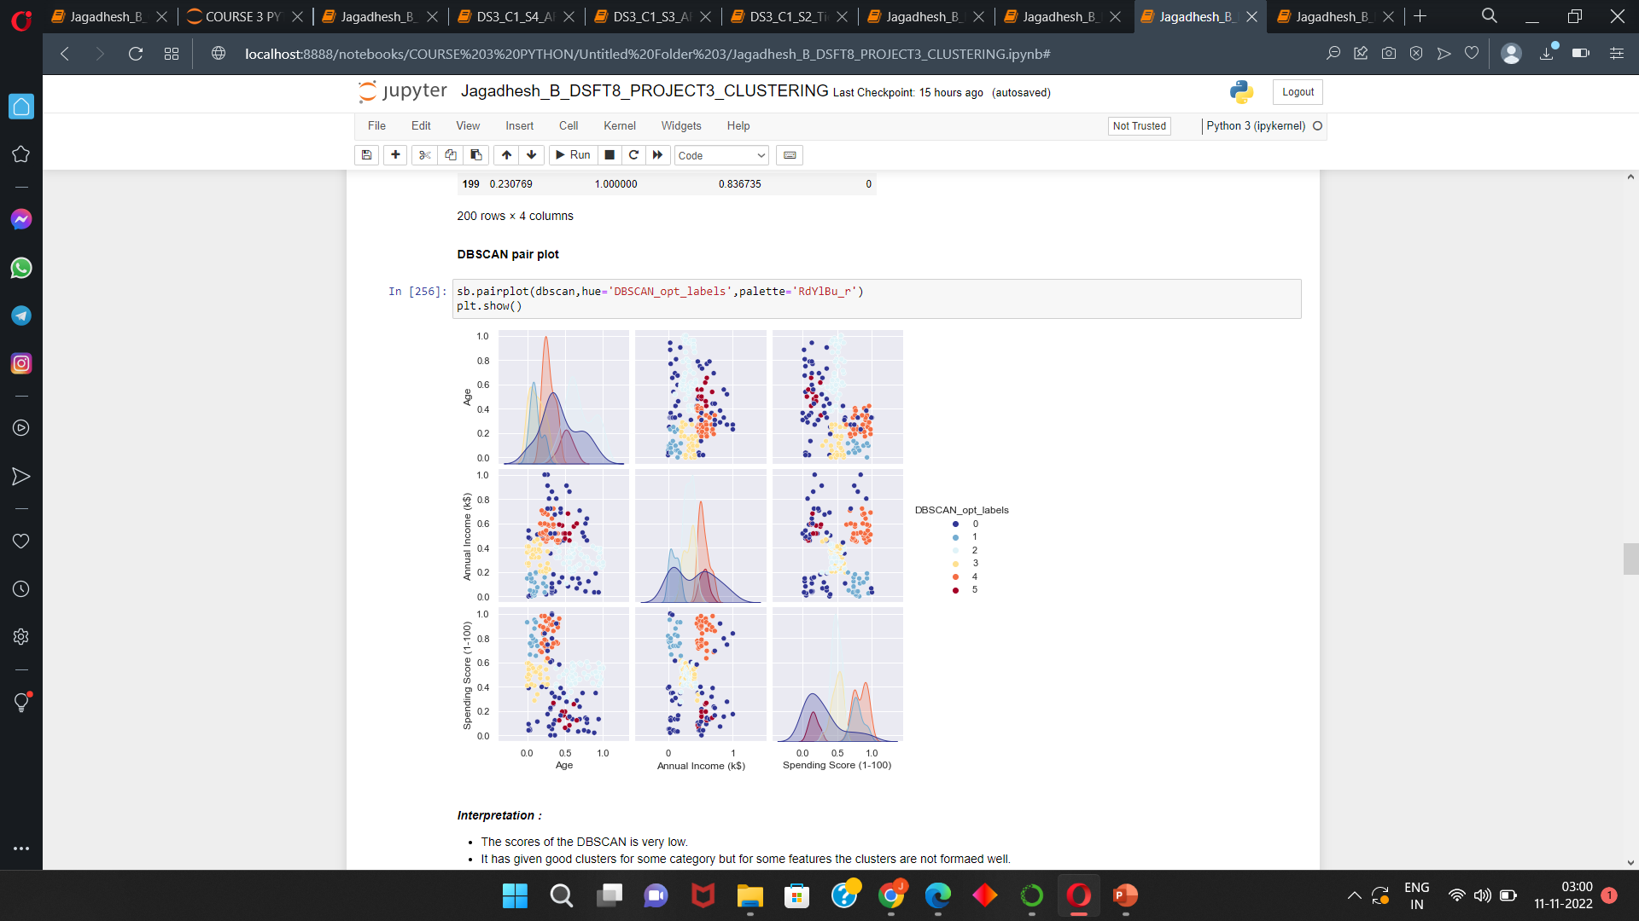
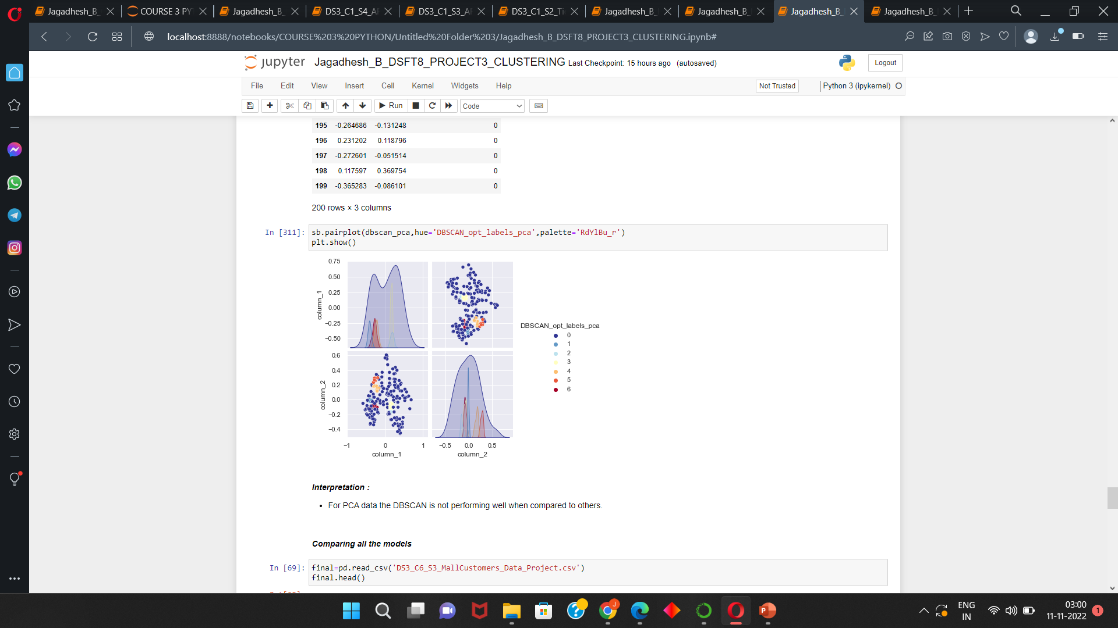
DBSCAN visual for actual and pca data :
For DBSCAN the hyper parameters are we need to select Epsilon value and mininum samples. For
Finding the epsilon we are using Nearest neighbour and plotting a visual.
We are not getting good clusters in DBSCAN for both actual and pca data.
The Silhoutte score for DBSCAN and pca data are 0.2575 and -0.3005 respectively.
From the below pair plot we can see that the some data in one cluster are joined with other
Clusters . For pca data we cant able to see the clusters also.

Slide 12
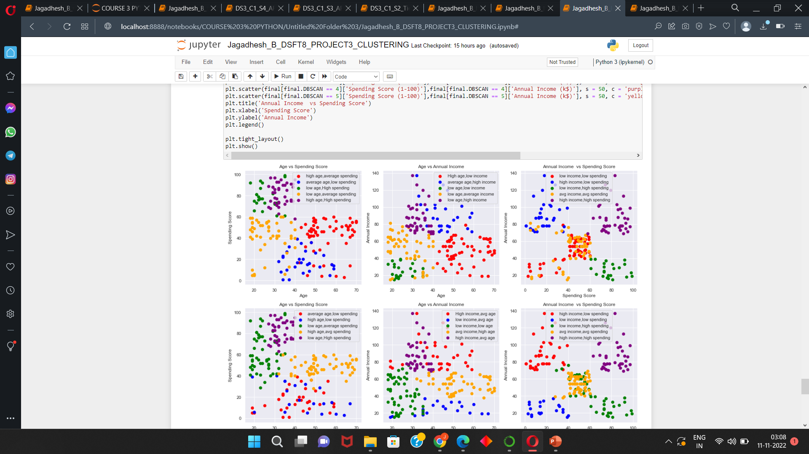
Giving Labels to the clusters by using the best model:
KMeans Model giving us good results and giving more silhouette score than compared to other models. So we are selecting Kmeans as our best model for both actual and pca data. We are given the labels for the each cluster through the legend

Slide 13
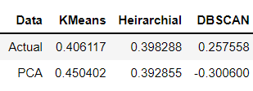
Interpretations :
Normal data :
For the normal data we are getting good performance in Kmeans = 0.4061 and Agglomerative = 0.3982.
DBSCAN not performed well as much as expected. Their score is 0.2575.
PCA data :
For PCA data also both KMeans and Agglomerative are performing well and their score are 0.4504 and 0.3928 respectively.
For DBSCAN the score are very low.
So for this data KMeans model performing well than compared to any other models.

Slide 14
Conclusion :
KMeans model performing well than compared to any other models So we are selecting kMeans as best model.
Business conclusion :
These are customers category formed by the Kmeans model.
If Kmeans 0 = These are the customers with high age,average spending,low income,low spending.
If Kmeans 1 = These are the customers with average age,low spending,high income.
If Kmeans 2 = These are the customers with low age,High spending,low income.
If Kmeans 3 = These are the customers with low age,average spending,average income.
If Kmeans 4 = These are the customers with high age,High spending,low age,high income,high spending’
From this clusters ,we can target the customers at the cluster 3 and 4 , because they are very low age and earning more but their spending is less. We can able to make them to spend more.

Slide 15
THANK YOU

